Slide 1

Parallel Array Sum Analysis
NAME: SAFIN CONNOR
GROUP : 4LF321A
YEAR: TI 3

Slide 2
TABLE OF CONTENTS
INTRODUCTION
OBJECTIVES
TECHNICAL SCOPE
RESULTS: TABLES AND GRAPHS
CONCLUSION

Slide 3
1. Introduction
This project is a comprehensive performance benchmarking study that systematically compares different computational approaches for calculating the sum of large integer arrays. It implements and analyzes six distinct methodologies ranging from basic sequential processing to advanced parallel computing techniques using OpenMP and Pthreads .

Slide 4
2. Objectives:
Demonstrate Parallel Computing Concepts - Provide hands-on experience with different parallelization strategies
Performance Analysis Methodology - Teach benchmarking and statistical analysis techniques
Optimization Strategy Comparison - Show that "more advanced" doesn't always mean "better performing"

Slide 5
3. Technical Scope
Implemented Methods:
Sequential Sum Single-threaded linear array traversal using basic for-loop. Serves as baseline reference with 1.00x speedup. Time complexity O(n), space complexity O(1).
Optimized Sequential - Loop unrolling technique processing four elements per iteration. Reduces loop control overhead by combining multiple additions into single statement. Cleanup loop handles remaining elements when array size is not divisible by four. Achieved best performance at 1.26x speedup.

Slide 6
OpenMP Parallel - Compiler-directive parallelization using pragma omp parallel for. Automatic work distribution across available threads. Reduction clause handles sum accumulation without race conditions. Underperformed with 0.12x speedup due to thread creation overhead exceeding benefits.
Pthread Parallel - Manual thread management with explicit pthread creation and joining. Custom work division calculating chunk sizes per thread. Each thread processes assigned array segment storing partial results. Main thread aggregates final sum after synchronization. Higher overhead than OpenMP at 0.15x speedup.

Slide 7
SIMD Optimized - Simulates vectorized operations processing four elements simultaneously. Groups integers into vector-sized chunks for parallel arithmetic. Real implementation would use SSE or AVX instructions. Simulation achieved 0.78x speedup without actual hardware vector support.
Cache Optimized - Processes data in cache-line-sized chunks of sixteen integers per sixty-four-byte line. Attempts maximizing cache utilization through aligned memory access patterns. Minimal improvement at 0.56x speedup since sequential access already cache-optimal.

Slide 8
4. a. Results Tables for Element Array Sizes
Execution Time (s)
SpeedUP Values (x)
Method | 500000 | 1000000 | 2000000
Sequential | 0.000114 | 0.000221 | 0.000479
Optimized Sequential | 0.000107 | 0.000211 | 0.000476
OpenMP Parallel | 0.000115 | 0.000226 | 0.000449
Pthread Parallel | .000202 | 0.000347 | 0.000668
SIMD Optimized | 0.000191 | 0.000380 | 0.000760
Cache Optimized | 0.000238 | 0.000483 | 0.000970
Method | 500000 | 1000000 | 2000000
Sequential | 1.00x | 1.00x | 1.00x
Optimized Sequential | 1.06x | 1.05x | 1.01x
OpenMP Parallel | 0.99x | 0.98x | 1.07x
Pthread Parallel | 10.56x | 0.64x | 0.72x
SIMD Optimized | 0.60x | 0.58x | 0.63x
Cache Optimized | 0.48x | 0.46x | 0.49x

Slide 9

4.B. Time Graph for Array Sizes

Slide 10
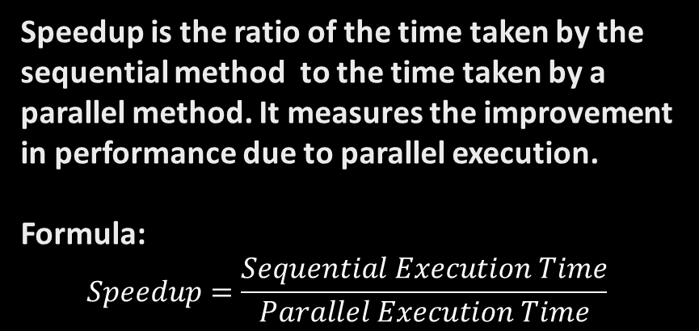
4.C. Speedup Graph for Array Sizes
Speedup is the ratio of the time taken by the sequential method to the time taken by a parallel method. It measures the improvement in performance due to parallel execution.
Formula: $$Speedup=\frac{Sequential Execution Time}{Parallel Execution Time}$$

Slide 11
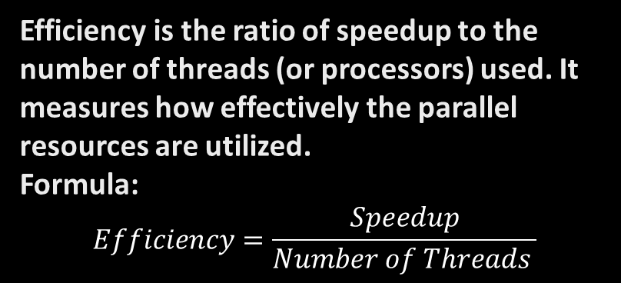
Efficiency Results Table for Array Sizes
Method | 500000 | 1000000 | 2000000
Sequential | 0.50 | 0.50 | 0.50
Optimized Sequential | 0.53 | 0.52 | 0.50
OpenMP Parallel | 0.49 | 0.49 | 0.53
Pthread Parallel | 0.28 | 0.32 | 0.36
SIMD Optimized | 0.30 | 0.29 | 0.32
Cache Optimized | 0.24 | 0.23 | 0.25
Efficiency is the ratio of speedup to the number of threads (or processors) used. It measures how effectively the parallel resources are utilized.
Formula: $$Efficiency=\frac{Speedup}{Number of Threads }$$

Slide 12
4.D. Efficiency Graph for Array Sizes

Slide 13
5. Conclusion
This comprehensive performance analysis of six different array summation methods has provided valuable insights into the practical realities of parallel computing optimization. The study systematically benchmarked sequential, parallel, and optimized approaches
across multiple array sizes.

